Slide 1
Fargo Connects Kick Off Event

Slide 2
Saddle Up for Fargo Connects
Western theme
Week long event
Pledges due by Monday October 16th
  Email will be sent on Friday October 13th as a reminder
  Team Taco Bar for department whose members all make a pledge
Goal for Fargo Connects: $50,000

Slide 3

Events
Horseshoe Toss
Crossword Puzzles
Pin the Tail on the Donkey
Obstacle Course
Chili Cook - Off
BINGO
Dunk the President

Slide 4
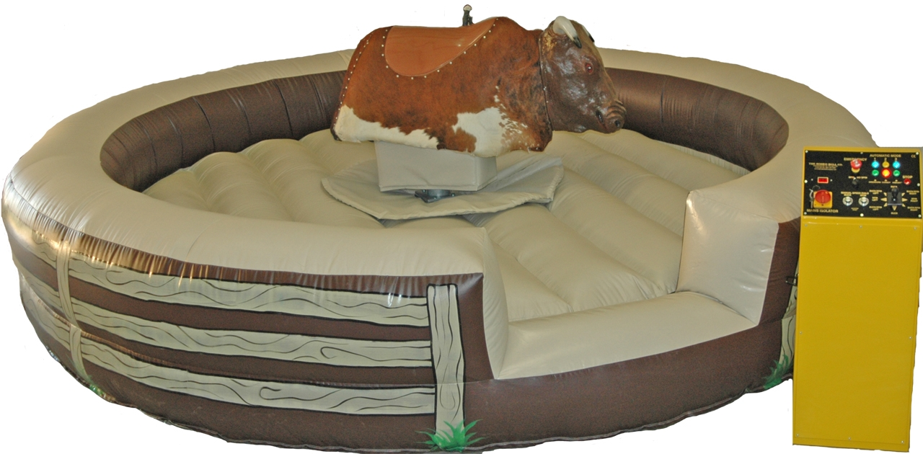
Mechanical Bull Ride

Slide 5
Line-Up
Monday - Pledges due by EOD
  Team that obtains 100% participation will receive Taco Bar
Tuesday - Game Day/Cake Walk
Western Clothes Wednesday
Thursday - Chili Cook-Off/Chili Dinner
Friday - Winners Announced
  Goal met: Dunk the President

Slide 6

Coloring sheets - $1/sheet
Badge retakes - $5
BINGO - $1/card

Slide 7
Chili Cook-Off and Dinner
Thursday at 5 PM
Hosted by Fit Wages at our Fargo location
Open to the community
Employee participation
BYOC - Bring Your Own Chili
Tickets on sale at the door - $5/adult, $3/child
Or included with your Sheriff Badge
Raised funds will be donated to Fargo Connects
Voting for best chili –winner will be announced

Slide 8

Sheriff Badges
$20/badge
Access to all events
10 crossword puzzles
10 BINGO cards

Slide 9
GOAL: $50,000

